Slide 1

Smart Study Planner using Strategy and Observer Pattern
Problem Statement :
Students often struggle to manage multiple academic tasks due to poor prioritization and lack of structured scheduling.
Target User :
Students who want an efficient way to organize tasks based on deadlines, difficulty, and study time.
Presented by
Debjit Dey : 2nd Year : IOTCSBT : Roll 02

Slide 2
System Design
Architecture
Key classes and Responsibilities
Task → base class for all tasks
AssignmentTask, ExamTask, ReadingTask → specific task types
SchedulerStrategy → defines scheduling method
DeadlineStrategy, DifficultyStrategy, BalancedStrategy → different scheduling logics
PlannerService → manages tasks and applies strategies
ReminderService → checks deadlines and alerts
TaskRepository → handles saving and loading data
ConsoleUI → manages user interaction
Console UI
Planner Service
Schedule Strategy
Package Structure
Task Model
model → task classes
strategy → scheduling logic
service → core operations
repository → file handling
ui → user interface
exception → custom exception
Repository

Slide 3
SmartStudyPlanner
├───data
│ tasks.txt
│
└───src
└───planner
│ Main.java
│
├───exception
│ InvalidTaskException.java
│
├───model
│ AssignmentTask.java
│ ExamTask.java
│ ReadingTask.java
│ Task.java
│
├───repository
│ TaskRepository.java
│
├───service
│ PlannerService.java
│ ReminderService.java
│
├───strategy
│ BalancedStrategy.java
│ DeadlineStrategy.java
│ DifficultyStrategy.java
│ SchedulerStrategy.java
│
└───ui
ConsoleUI.java
File
Structure

Slide 4
OOP Concepts Used
Abstraction
Task is an abstract class defining common properties and behavior for all tasks
Inheritance
AssignmentTask, ExamTask, ReadingTask extend Task
Enables code reuse and specialization
Exception Handling
Custom exception for invalid input
Try-catch used for handling runtime errors
Design Pattern Used
Strategy PatternDifferent scheduling algorithms implemented separately
Selected dynamically at runtime
Observer Concept (Basic)Reminder system checks and notifies about deadlines
Polymorphism
SchedulerStrategy interface allows different scheduling behaviors
Strategy can be changed at runtime
Encapsulation
Task data is private and accessed using getters and setters

Slide 5
Technical Highlights
The program uses Strategy Pattern to implement multiple types of scheduling techniques
allowing the user to switch between different techniques in run time
common interface defines a scheduling method:
schedule(List<Task>)
Multiple classes implement this interface
Deadline-based scheduling - sorts by nearest deadline
Difficulty-based scheduling - sorts by highest difficulty
Balanced scheduling - calculates a score using multiple factors
The selected strategy is assigned at runtime:
The service class calls the active strategy to schedule tasks
Design Strategy
This approach was chosen because :
It avoids hardcoding a single scheduling logic
Allows dynamic behavior change at runtime
Makes the system easily extensible
Improves separation of concerns
Why this Strategy

Slide 6
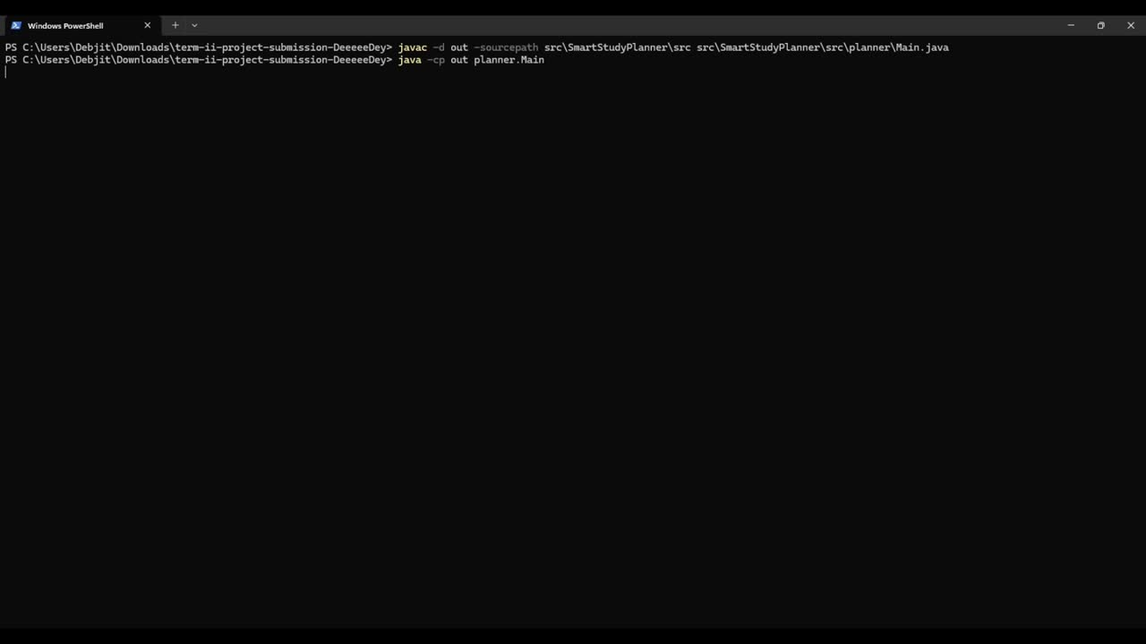
Demo

Slide 7
Thank
You

